Slide 1
Hotel Management System
By Ehtisham Ul Haq, M. Azeem, Hassan Abbas

Slide 2
Identifying Entities
Staff
Hotel
Room
Guest
Reservation
Payment
Feedback

Slide 3
Adding more entities
Invoice(Invoice for payments)
Service
Type(For Rooms)

Slide 4
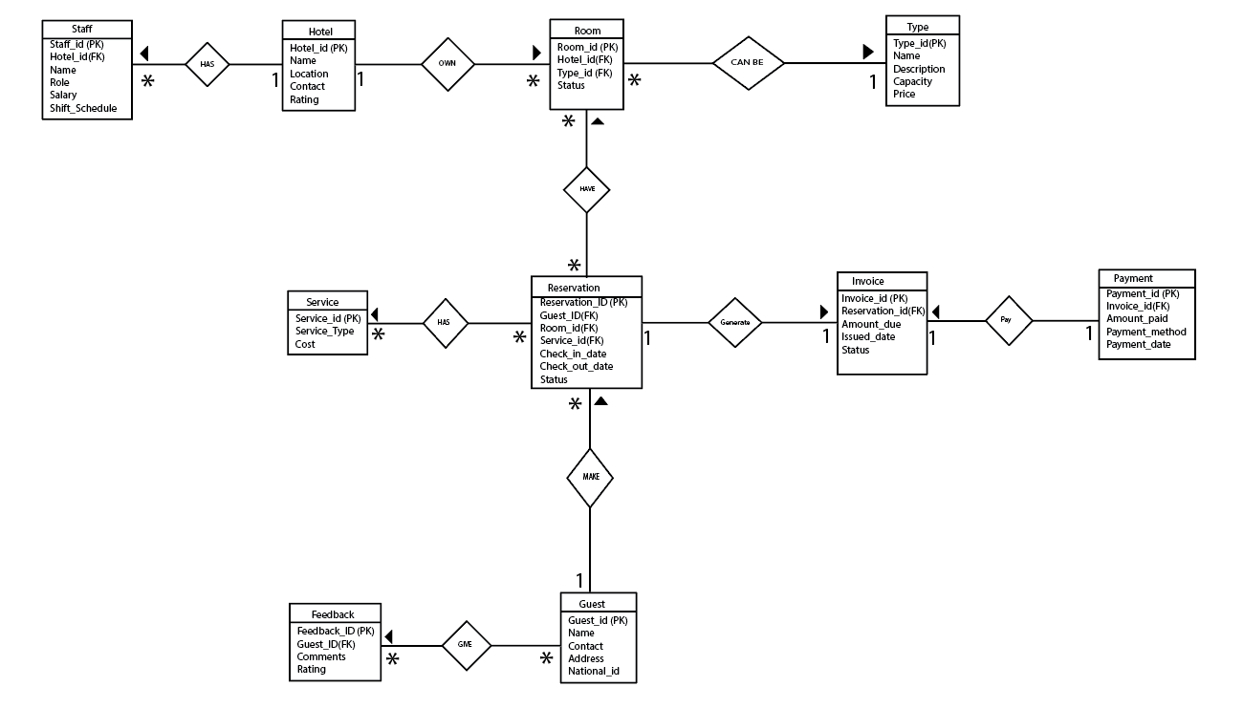
ERD

Slide 5
Entities With Primary and Foreign keys
Staff (Staff_id (PK),Hotel_id(FK))
Hotel (Hotel_id(PK))
Room(Room_id(PK),Hotel_id(FK),Type(FK))
Type (Type_id(PK))
Reservation(Reservation_id(PK),Room_id,invoice_id,Service_id,Guest_id(FK))
Service(Service_id(PK))
Invoice(Invoice_id(PK),Reservation_id(PK))
Payment (Payment_id(PK),Invoice_id(FK))
Guest (Guest_id(PK))
Feedback (Feedback_id(PK),Guest_id(FK))

Slide 6
Alternative Keys
Hotel
Contact
Guest
National_id
Payment
Invoice_id
Invoice
Reservation_id,issued_date

Slide 7
Thanks

